Slide 1
Time Tracker

Slide 2
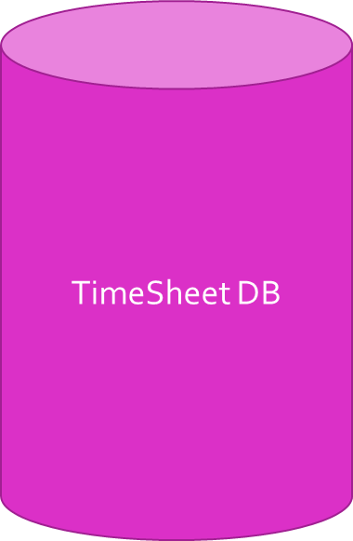
S1: Calendar
Calendar based GUI
Option to Display Calendar
-- can move through months
(Default display is current month)

Slide 3
S2: Dropdown List with Synced Features
Description of Activity during Shift
GUI with imported calendar with dates as buttons
Dropdown list for activity options created by HLU (includes ‘Break’ and ‘Other: Specify’) (list contains projects given by HLU)
Program to specify activity if not part of the drop down list

Slide 4
S3: Start/Stop Button with Stopwatch
Timesheet DB
Tabularize Log-in/Log-out time per activity
Clock GUI
Start/stop button to initialize stopwatch (automatically started with activity)

Slide 5
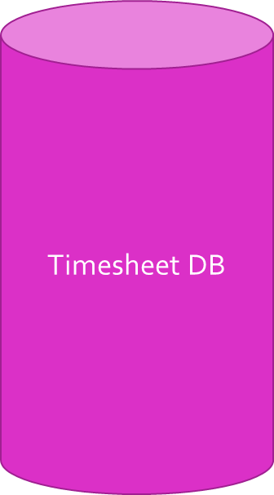
S4: Text Area for Additional Comments
Option to send message to HLU
(Example: Status update on the current project)
-- Option to specify priority level
CharField

Slide 6
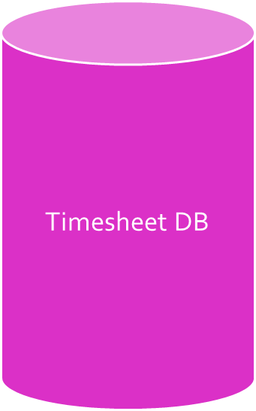
S5+S6: Submission for Approval and Saving as Draft
Send Timesheet for Approval
-- Report sent to HLU automatically at the end of the day
Option to generate a daily report/view saved as drafts (bullets customizable by HLU)
-- Each shift: Name of activity and hours spent on activity
-- Total hours (adds hours of shifts work)
-- Meetings attended
Save as Draft to customize
User’s local Storage
Button

Slide 7
S7: Attendance Reflected by TimeTracker Activities
Timesheet DB
Marks Attendance and Reflects in Timesheet
Button
Apply for Leave
-- Reason for Leave Request
Notes:
Add S8 and S9

Slide 8
S8:Project Status
Public
Status Variable set to LLU's under Respective HLU
Calendar based GUI
Options to display as Public/Private
Read all Assignments
Dropdown List GUI
CheckBox GUI
Status variable set to send to HLU only
Private

